Slide 1
Data Modeling Introduction
Flexible Schema
Unlike SQL databases, where you must determine and declare a table’s schema before inserting data, MongoDB’s collections, by default, does not require its documents to have the same schema. That is:
The documents in a single collection do not need to have the same set of fields and the data type for a field can differ across documents within a collection.
To change the structure of the documents in a collection, such as add new fields, remove existing fields, or change the field values to a new type, update the documents to the new structure.
Document Structure
The key decision in designing data models for MongoDB applications revolves around the structure of documents and how the application represents relationships between data. MongoDB allows related data to be embedded within a single document.

Slide 2
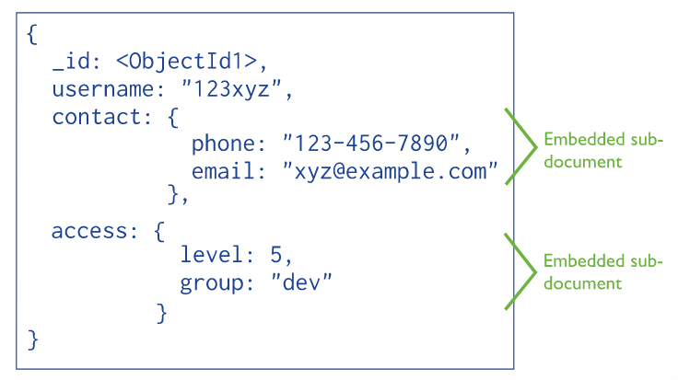
Data Modeling Introduction
Embedded documents capture relationships between data by storing related data in a single document structure. MongoDB documents make it possible to embed document structures in a field or array within a document.
These denormalized data models allow applications to retrieve and manipulate related data in a single database operation.
For many use cases in MongoDB, the denormalized data model is optimal.

Slide 3
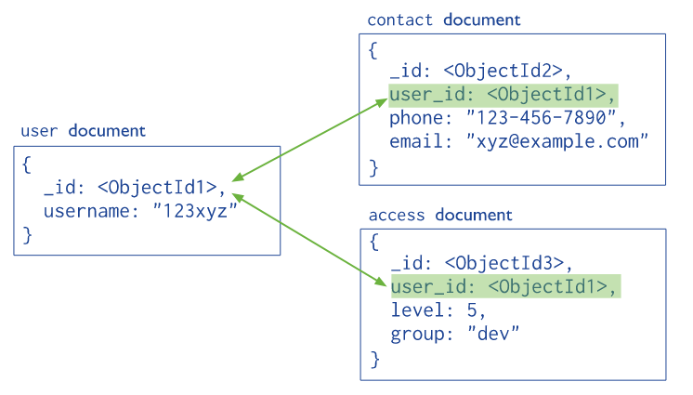
Data Modeling Introduction
References store the relationships between data by including links or references from one document to another.
Applications can resolve these references to access the related data. Broadly, these are normalized data models.

Slide 4
Data Modeling Introduction
Atomicity of Write Operations
In MongoDB, a write operation is atomic on the level of a single document, even if the operation modifies multiple embedded documents within a single document.
A denormalized data model with embedded data combines all related data in a single document instead of normalizing across multiple documents and collections. This data model facilitates atomic operations.
When a single write operation (e.g. db.collection.updateMany()) modifies multiple documents, the modification of each document is atomic, but the operation as a whole is not atomic.
Data Use and Performance
When designing a data model, consider how applications will use your database. For instance, if your application only uses recently inserted documents, consider using Capped Collections. Or if your application needs are mainly read operations to a collection, adding indexes to support common queries can improve performance.

Slide 5
Data Modelling in MongoDB
https://docs.mongodb.com/manual/tutorial/model-embedded-one-to-one-relationships-between-documents/

